Slide 1
The viterbi algorithm
A.J. Han Vinck
Lecture notes data communications
10.01.2009

Slide 2
content
Viterbi decoding for convolutional codes
Hidden Markov models
With contributions taken from Dan Durafsky

Slide 3
Problem formulation
noise
information
x
n
Finite State Machine
observation
y = x + n
What is the best estimate for the information given the observation?
Maximum Likelihood receiver:
max P( Y | X ) = max P( X+N | X ) = max P( N )
for independent transmissions = max Π_{i=1,L} P( N_{i} )
≡ minimum weight noise sequence

Slide 4
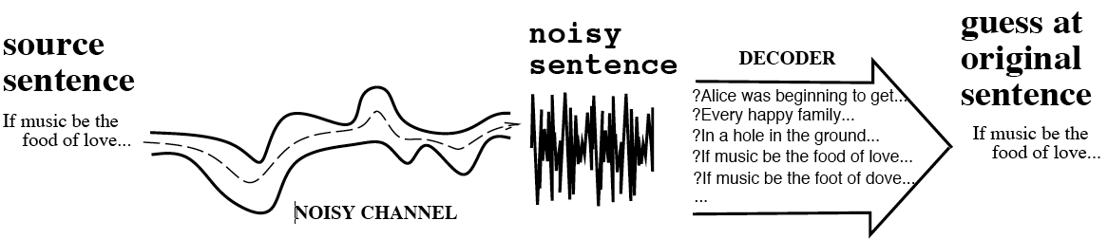
The Noisy Channel Model
Search through space of all possible sentences.
Pick the one that is most probable given the waveform.

Slide 5
characteristics
the Viterbi algorithm is a standard component of tens of millions of high-speed modems. It is a key building block of modern information infrastructure
The symbol "VA" is ubiquitous in the block diagrams of modern receivers.
Essentially:
the VA finds a path through any Markov graph, which is a sequence of states governed by a Markov chain.
many practical applications:
  convolutional decoding and channel trellis decoding.
  fading communication channels,
  partial response channels in recording systems,
  optical character recognition,
  voice recognition.
  DNA sequence analysis
  etc.

Slide 6
Illustration of the algorithm
st 1 0.7 st 2
0.5 0.2
IEM 0.5 1.2 UNI
0.8 0.2
st 3 st 4
0.8
0.5
1.2
1.2
0.8
1.0
survivor

Slide 7
Key idea
F
A
B
C
D
E
Best path from A to C = best of
- the path A-F-C
- best path A to B + best path from B to C
- the path via D does not influence the best way from B to C

Slide 8
Application to convolutional code
Info code code + noise estimate
encoder
VD
channel
c1
c1⊕ n1
n1
I
binary noise sequences
P(n1=1)=P(n2=1) = p
delay
n2
c2⊕ n2
c2
VITERBI DECODER: find sequence I‘ that corresponds to code sequence ( c1, c2 ) at minimum distance from (r1,r2) = (c1 ⊕ n1, c2 ⊕ n2)

Slide 9
Use encoder state space
I
delay
c2
00
00
00
00
State 0
11
11
11
11
•••
10
10
10
10
State 1
01
01
01
01
Time 0 1 2 3

Slide 10
Encoder output 00 11 10 00
00
00
00
00
State 0
11
11
11
11
•••
10
10
10
State 1
01
01
01
channel output 00 10 10 00
00
0
00
1
00
1
00
1
State 0
best
11
11
11
11
•••
10
10
10
State 1
2
01
1
01
2
01
3

Slide 11
Viterbi Decoder action
VITERBI DECODER:
Maximum Likelihood receiver: find ( c1, c2 ) that maximizes
Probability ( r1, r2 | c1, c2 ) = Prob ( c1 ⊕ n1, c2 ⊕ n2 | c1, c2 ) =
= Prob ( n1, n2 )
= minimum # noise digits equal to 1

Slide 12
Distance Properties of Conv. Codes
Def: The free distance, d_{free} = minimum Hamming distance between any two code sequences.
Criteria for good convolutional codes:
  1. Large free distance, d_{free}.
  2. Small numer of information bits = 1 in sequences with low Hamming weight
There is no known constructive way of designing a convolutional code of given distance properties.
However, a given code can be analyzed to find its distance properties.

Slide 13
Distance Prop. of Convolutional Codes (cont’d)
Convolutional codes are linear.
Therefore, the Hamming distance between any pair of code sequences corresponds to the Hamming distance between the all-zero code sequence and some nonzero code sequence.
The nonzero sequence of minimum Hamming weight diverges from the all-zero path at some point and remerges with the all-zero path at some later point.
Convolutional Codes <number>

Slide 14
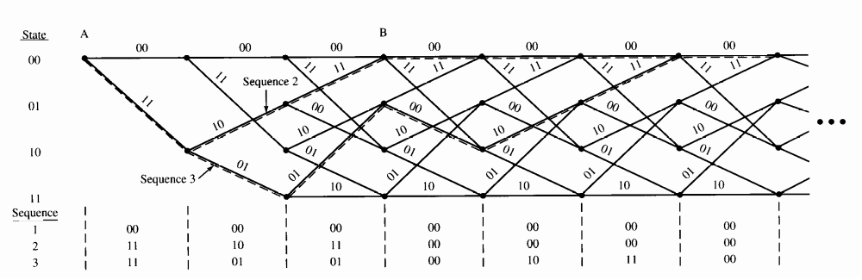
Distance Properties: Illustration
sequence 2: Hamming weight = 5, d_{inf} = 1
sequence 3: Hamming weight = 7, d_{inf} = 3.

Slide 15
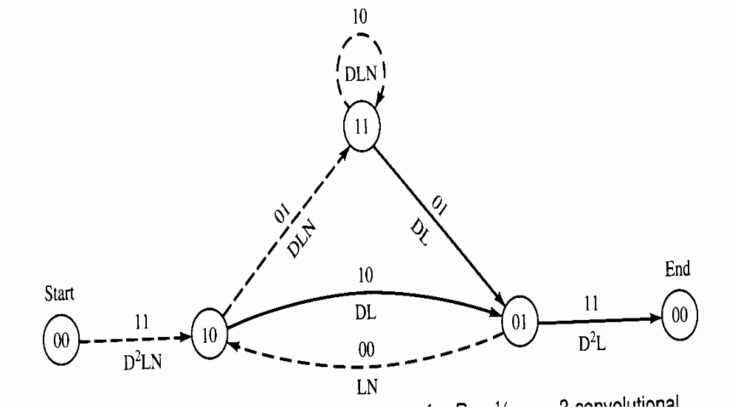
Modified State Diagram (cont’d)
A path from (00) to (00) is denoted by
D^{i} (weight)
L^{j} (length)
N^{k} (# info 1‘s)

Slide 16
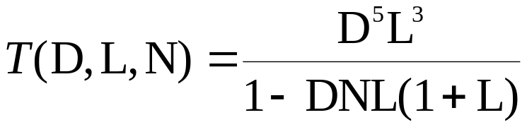
Transfer Function
The transfer function T(D,L,N)

Slide 17
Transfer Function (cont’d)
Performing long division:
  T(D,L,N) = D⁵L³N + D⁶L⁴N² + D⁶L⁵N² + D⁷L⁵N³ + ….
If interested in the Hamming distance property of the code only,
set N = 1 and L = 1 to get the distance transfer function:
  T (D) = D⁵ + 2D⁶ + 4D⁷ + …
  There is one code sequence of weight 5. Therefore d_{free}=5.
  There are two code sequences of weight 6,
  four code sequences of weight 7, ….

Slide 18
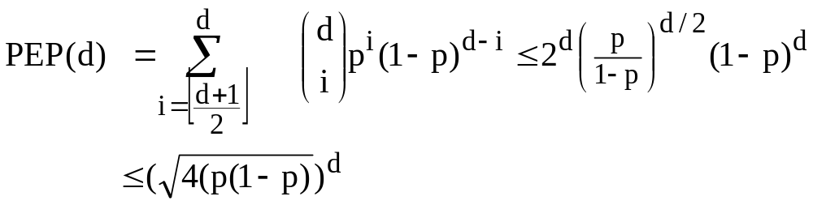
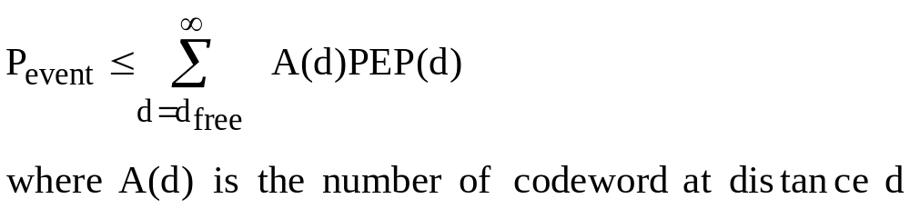
performance
correct
node
incorrect
The event error probability is defined as the probability that the decoder selects a code sequence that was not transmitted
For two codewords the Pairwise Error Probability is
The upperbound for the event error probability is given by

Slide 19
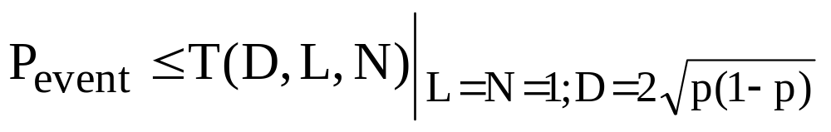
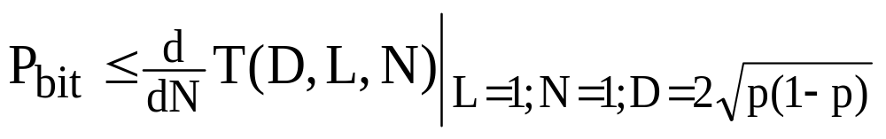
performance
using the T(D,N,L), we can formulate this as
The bit error rate (not probability) is written as

Slide 20
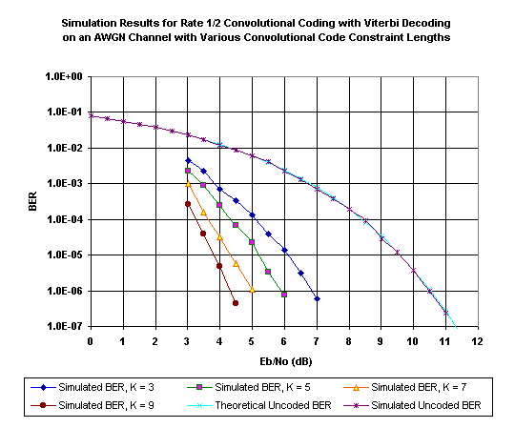
The constraint length of the ½ convolutional code: k = 1 + # memory elements
Complexity Viterbi decoding: proportional to 2^{K} (number of different states)

Slide 21
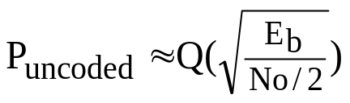
PERFORMANCE:
theoretical uncoded BER given by
where Eb is the energy per information bit
for the uncoded channel, E_{s}/N₀ = E_{b}/N₀, since there is one channel symbol per bit.
for the coded channel with rate k/n, nE_{s} = kE_{b} and thus E_{s} = E_{b} k/n
The loss in the signal to noise ratio is thus -10log₁₀ k/n dB
for rate ½ codes we thus loose 3 dB in SNR at the receiver

Slide 22
metric
We determine the Hamming distance between the received symbols and the code symbols
d(x, y) is called a metric
Properties:
d(x, y) ≥ 0 (non-negativity)
d(x, y) = 0 if and only if x = y (identity)
d(x, y) = d(y, x) (symmetry)
d(x, z) ≤ d(x, y) + d(y, z) (triangle inequality).

Slide 23
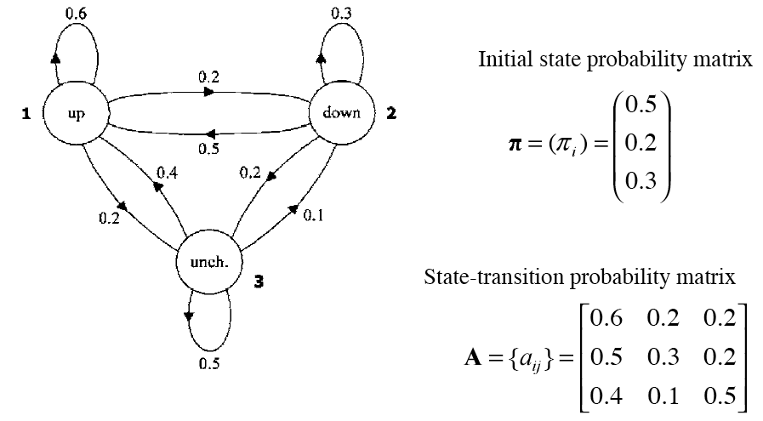
Markov model for Dow Jones
Figure from Huang et al, via

Slide 24
Markov Model for Dow Jones
What is the probability of 5 consecutive up days?
Sequence is up-up-up-up-up
I.e., state sequence is 1-1-1-1-1
P(1,1,1,1,1) =
  π₁a₁₁a₁₁a₁₁a₁₁ = 0.5 x (0.6)⁴ = 0.0648

Slide 25
Application to Hidden Markov Models
Definition:
The HMM is
a finite set of states, each of which is associated with a probability distribution.
transitions among the states are governed by a set of probabilities called transition probabilities.
In a particular state an outcome or observation can be generated, according to the associated probability distribution.
It is only the outcome, not the state visible to an external observer and therefore states are ``hidden'' to the outside; hence the name Hidden Markov Model.
EXAMPLE APPLICATION: speech recognition and synthesis

Slide 26
Example HMM for Dow Jones (from Huang et al.)
0.7
0.1
0.2
0.1
0.6
0.3
0.2
0.6
1
2
0.3
0.5
0.4
0.2
0.2
0.1
0.5
0.2 = initial state probability
0.3
P(up)
P(down) =
P(no-change)
3
0.3
0.3
0.4
0.6
0.5
0.4
0.2
0.3
0.1
0.2
0.2 transition matrix
0.5
0.5

Slide 27
Calculate
Probability ( observation | model )
Probability, UP, UP, UP, ***
Trellis:
0.7
0.1
0.2
0.35*0.6*0.7
0.179*0.6*0.7
0.5
0.35
0.179
0.02*0.5*0.7
0.008*0.5*0.7
0.09*0.4*0.7
0.1
0.6
0.3
0.2
0.02
0.008
0.036*0.4*0.7
0.35*0.2*0.3
P(up)
P(down)
P(no-change)
0.3
0.3
0.4
0.02*0.2*0.3
0.3
0.09
0.036
0.09*0.5*0.3
0.6
0.5
0.4
0.2
0.3
0.1
0.2
0.2 transition matrix
0.5
0.46
0.223
add probabilities !

Slide 28
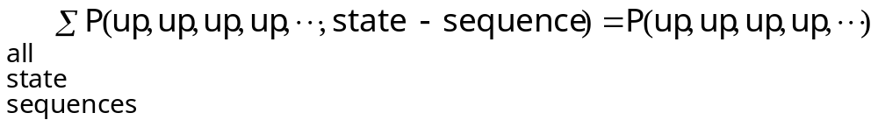
Calculate
Probability ( observation | model )
Note: The given algorithm calculates

Slide 29
Calculate max_{S} Prob( up, up, up and state sequence S )
Observation is (UP, UP, UP, *** )
0.7
0.1
0.2
0.35*0.6*0.7
0.147*0.6*0.7
best
0.5
0.35
0.147
0.02*0.5*0.7
0.007*0.5*0.7
0.09*0.4*0.7
0.1
0.6
0.3
0.2
0.02
0.007
0.021*0.4*0.7
0.35*0.2*0.3
P(up)
P(down)
P(no-change)
0.3
0.3
0.4
0.02*0.2*0.3
0.3
0.09
0.021
0.09*0.5*0.3
0.6
0.5
0.4
0.2
0.3
0.1
0.2
0.2 transition matrix
0.5
Select highest probability !

Slide 30
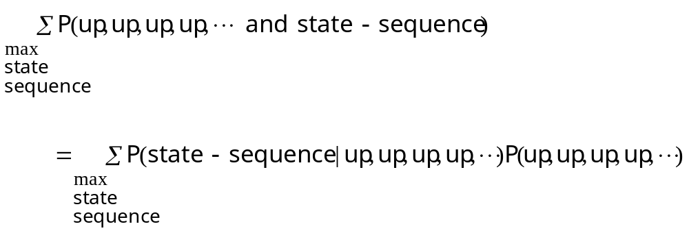
Calculate max_{S} Prob( up, up, up and state sequence S )
Note: The given algorithm calculates
Hence, we find
the most likely state sequence given the observation

Slide 31
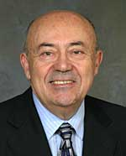
06 June 2005 08:00 AM (GMT -05:00)
(From The Institute print edition)
Viterbi Receives Franklin Medal
Send Link
Printer Friendly
Andrew Viterbi
As a youth, Life Fellow Andrew Viterbi never envisioned that he’d create an algorithm used in every cellphone or that he would cofound Qualcomm, a Fortune 500 company that is a worldwide leader in wireless technology.
Viterbi came up with the idea for that algorithm while he was an engineering professor at the University of California at Los Angeles (UCLA) and then at the University of California at San Diego (UCSD), in the 1960s. Today, the algorithm is used in digital cellphones and satellite receivers to transmit messages so they won’t be lost in noise. The result is a clear undamaged message thanks to a process called error correction coding. This algorithm is currently used in most cellphones.
“The algorithm was originally created for improving communication from space by being able to operate with a weak signal but today it has a multitude of applications,” Viterbi says.
For the algorithm, which carries his name, he was awarded this year’s Benjamin Franklin Medal in electrical engineering by the Franklin Institute in Philadelphia, one of the United States’ oldest centers of science education and development. The institute serves the public through its museum, outreach programs, and curatorial work. The medal, which Viterbi received in April, recognizes individuals who have benefited humanity, advanced science, and deepened the understanding of the universe. It also honors contributions in life sciences, physics, earth and environmental sciences, and computer and cognitive sciences.
Qualcomm wasn’t the first company Viterbi started. In the late 1960s, he and some professors from UCLA and UCSD founded Linkabit, which developed a video scrambling system called Videocipher for the fledgling cable network Home Box Office. The Videocipher encrypts a video signal so hackers who haven’t paid for the HBO service can’t obtain it.
Viterbi, who immigrated to the United States as a four-year-old refugee from facist Italy, left Linkabit to help start Qualcomm in 1985. One of the company’s first successes was OmniTracs, a two-way satellite communication system used by truckers to communicate from the road with their home offices. The system involves signal processing and an antenna with a directional control that moves as the truck moves so the antenna always faces the satellite. OmniTracs today is the transportation industry’s largest satellite-based commercial mobile system.
Another successful venture for the company was the creation of code-division multiple access (CDMA), which was introduced commercially in 1995 in cellphones and is still big today. CDMA is a “spread-spectrum” technology—which means it allows many users to occupy the same time and frequency allocations in a band or space. It assigns unique codes to each communication to differentiate it from others in the same spectrum.
Although Viterbi retired from Qualcomm as vice chairman and chief technical officer in 2000, he still keeps busy as the president of the Viterbi Group, a private investment company specializing in imaging technologies and biotechnology. He’s also professor emeritus of electrical engineering systems at UCSD and distinguished visiting professor at Technion-Israel Institute of Technology in Technion City, Haifa. In March he and his wife donated US $52 million to the University of Southern California in Los Angeles, the largest amount the school ever received from a single donor.
To honor his generosity, USC renamed its engineering school the Andrew and Erna Viterbi School of Engineering. It is one of four in the nation to house two active National Science Foundation–supported engineering research centers: the Integrated Media Systems Center (which focuses on multimedia and Internet research) and the Biomimetic Research Center (which studies the use of technology to mimic biological systems).

